Slide 1


Blueprint Activity
Mark Neubauer
University of Illinois at Urbana-Champaign
NSF / IRIS-HEP Meeting
Sept 18, 2019

Slide 2
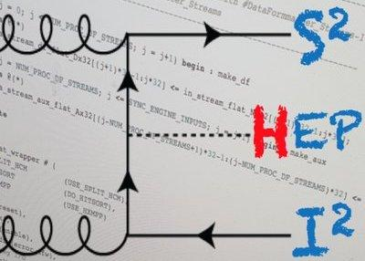
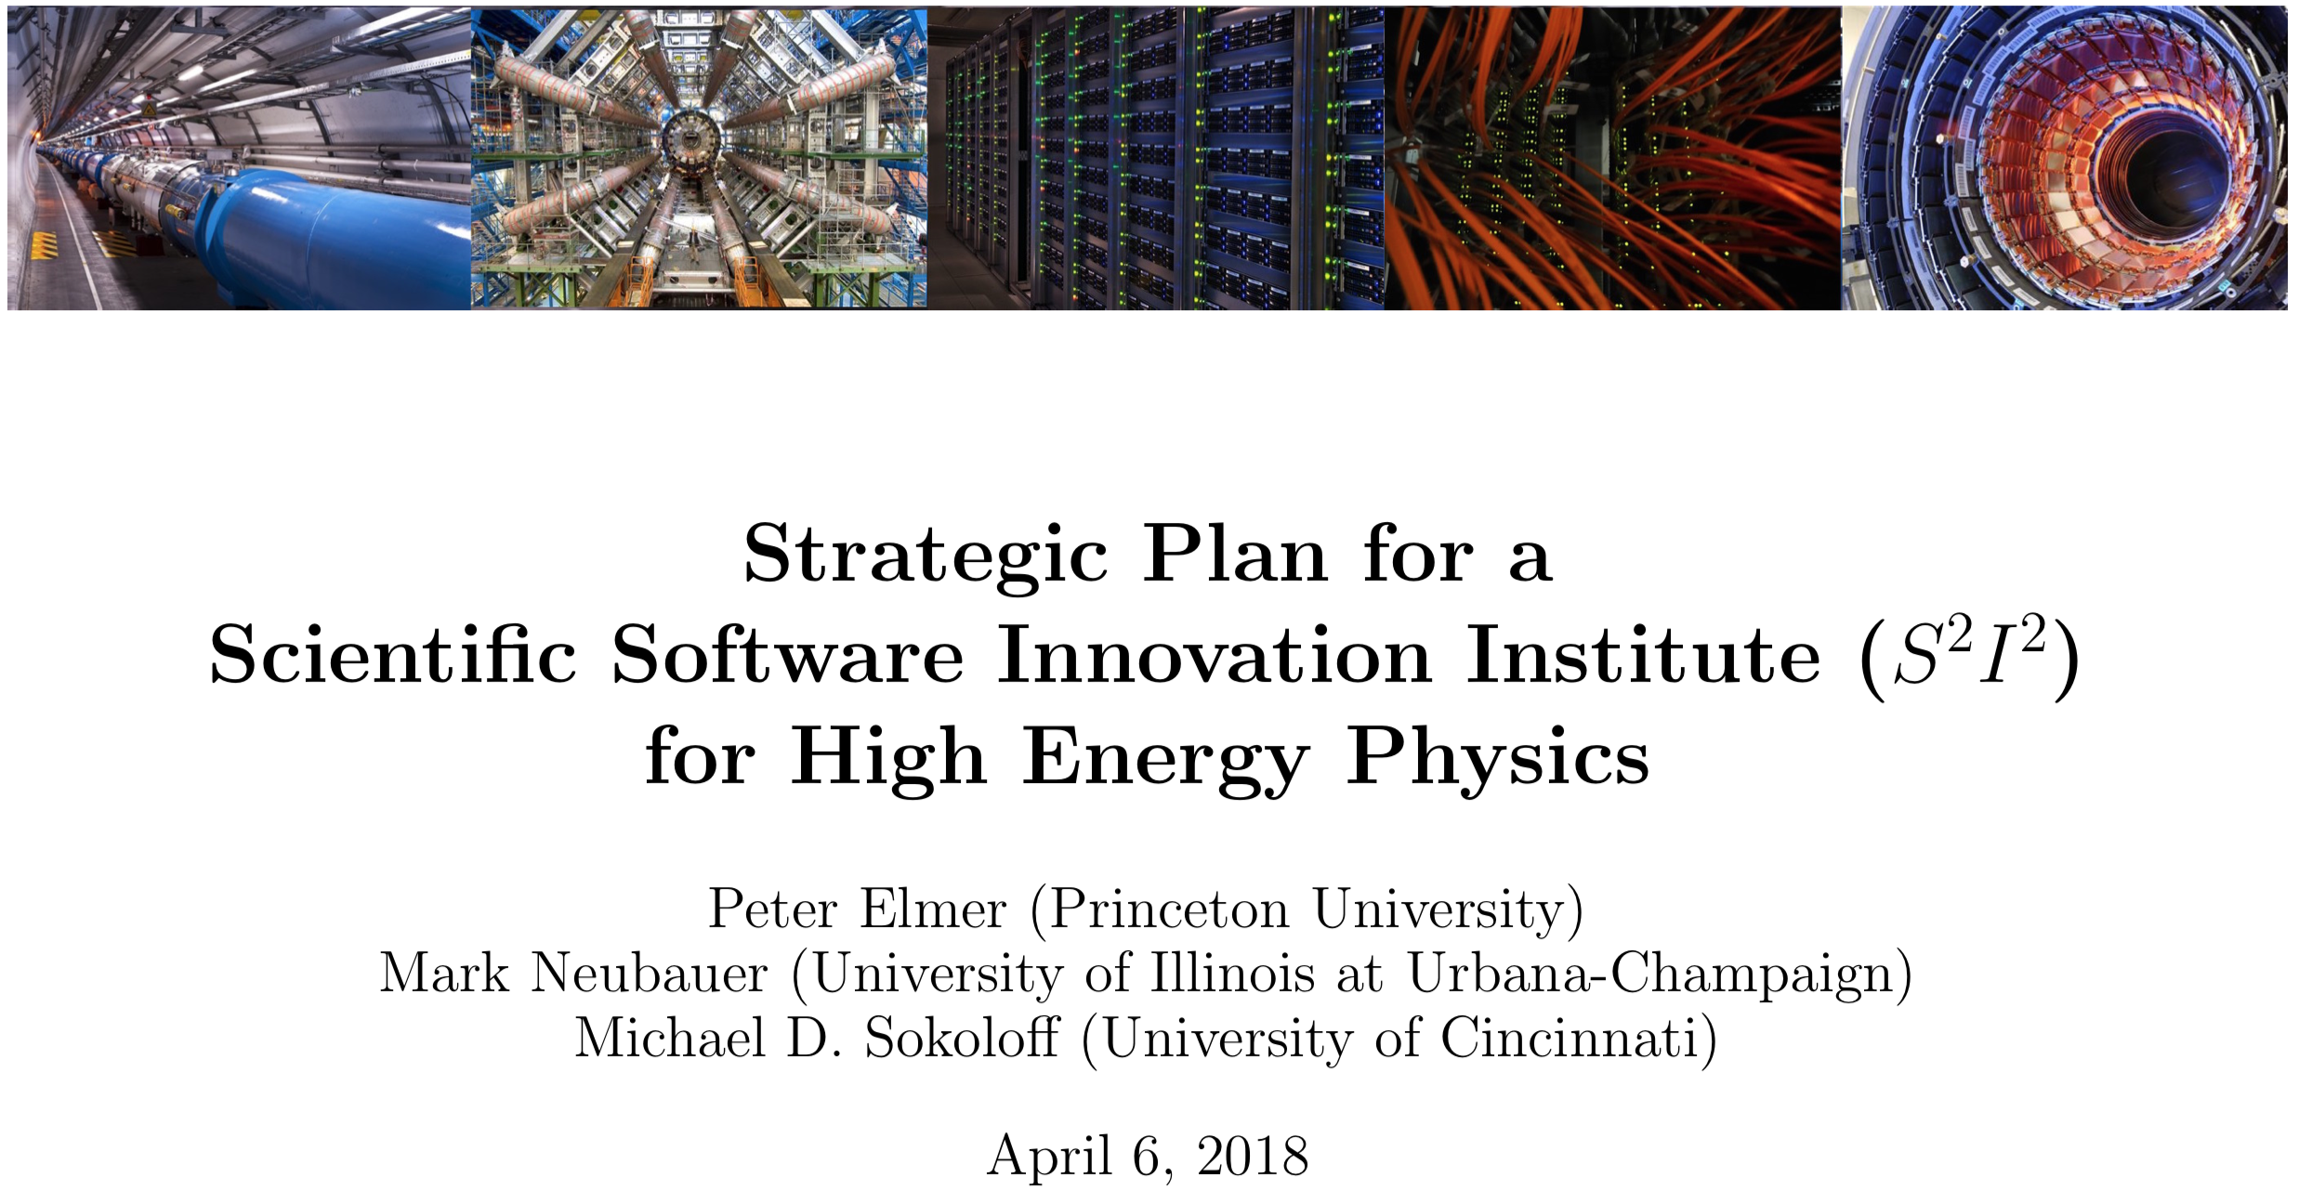
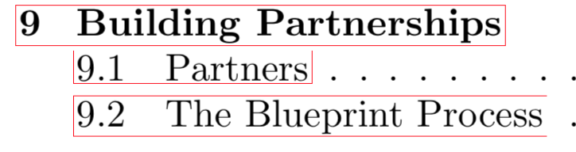
Foundations
IRIS-HEP Conceptualization (S²I²-HEP)
It was recognized early on in the community process of developing the HEP Software Institute concept that its success depends on an informed evolution of its activities, planning (direction), and (possibly) structure
It was suggested to formalize this into a Blueprint Activity that was written into the S²I²-HEP Strategic Plan submitted to the NSF
arXiv 1712.06592

Slide 3
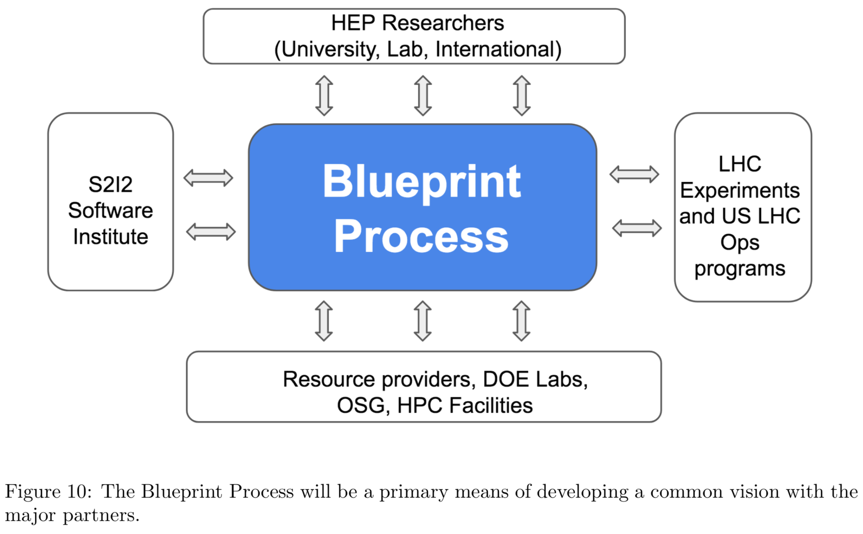
Foundations
IRIS-HEP Conceptualization (S²I²-HEP)

Slide 4
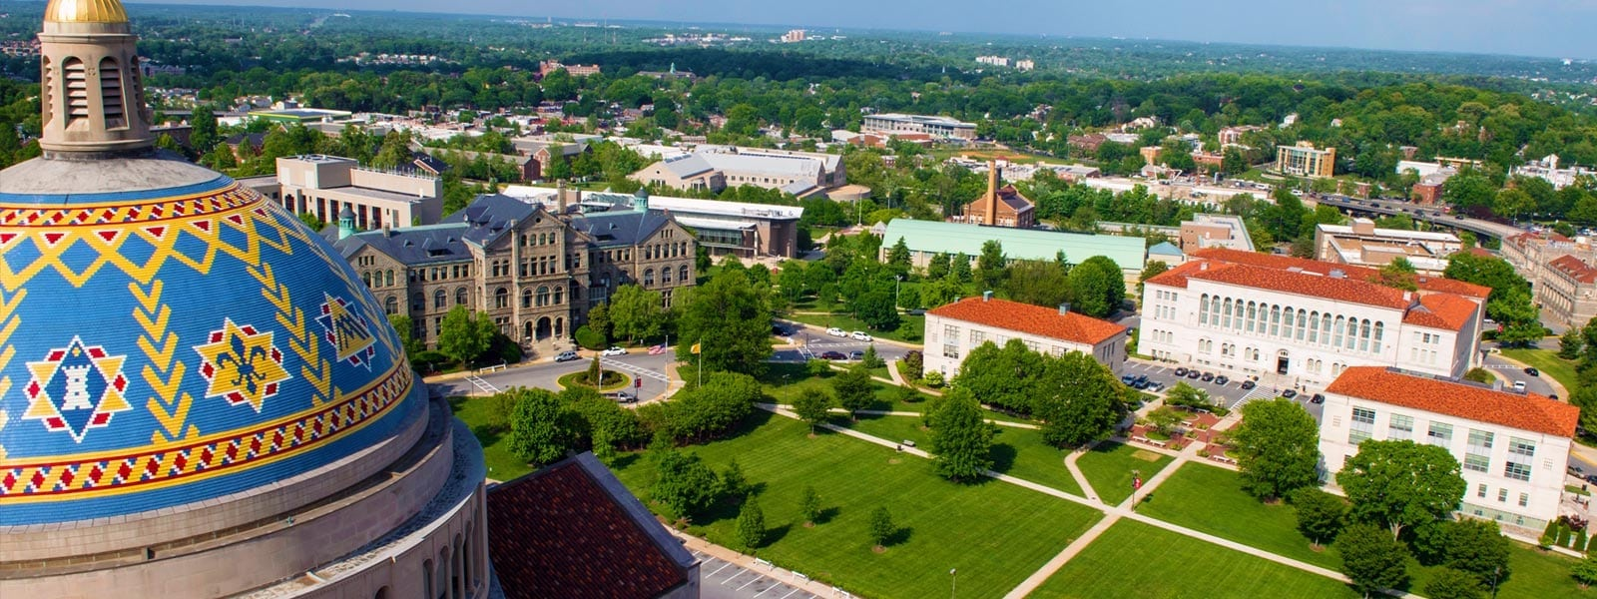
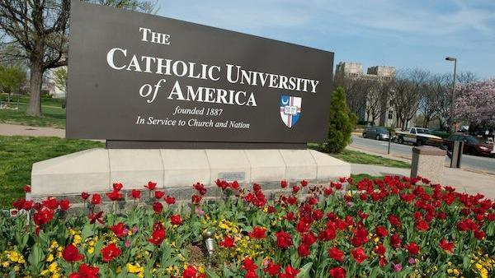
The First “Blueprint” Meeting
IRIS-HEP Conceptualization (S²I²-HEP)
S²I²-HEP/DOE Mini-workshop on HL-LHC Software & Computing R&D
Held at the Catholic University of America on November 28-29, 2017

Slide 5
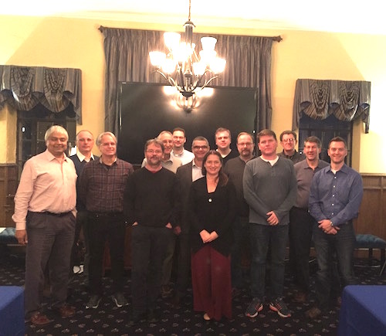
The First “Blueprint” Meeting
IRIS-HEP Conceptualization (S²I²-HEP)
S²I²-HEP/DOE Mini-workshop on HL-LHC Software & Computing R&D
Held at the Catholic University of America on November 28-29, 2017
Involved US ATLAS/CMS S&C Ops management, representatives from Labs (FNAL, ANL, LBNL, BNL, SLAC), DOE Program Officers, and S²I²-HEP
Theme: Coherence & Alignment
Discussion around vision for US R&D efforts for HL-LHC (using impact criteria), how R&D and Ops efforts would interact and help each other

Slide 6
Blueprint Activity and Process
The Blueprint activity is used to inform the development and evolution of the IRIS-HEP strategic vision
A series of workshops that bring together IRIS-HEP team members, key stakeholders and domain experts from disciplines of importance to the Institute’s mission
Topical presentations and breakout sessions
Discussions are captured and they inform the key outcomes which are summarized in a short report

Slide 7
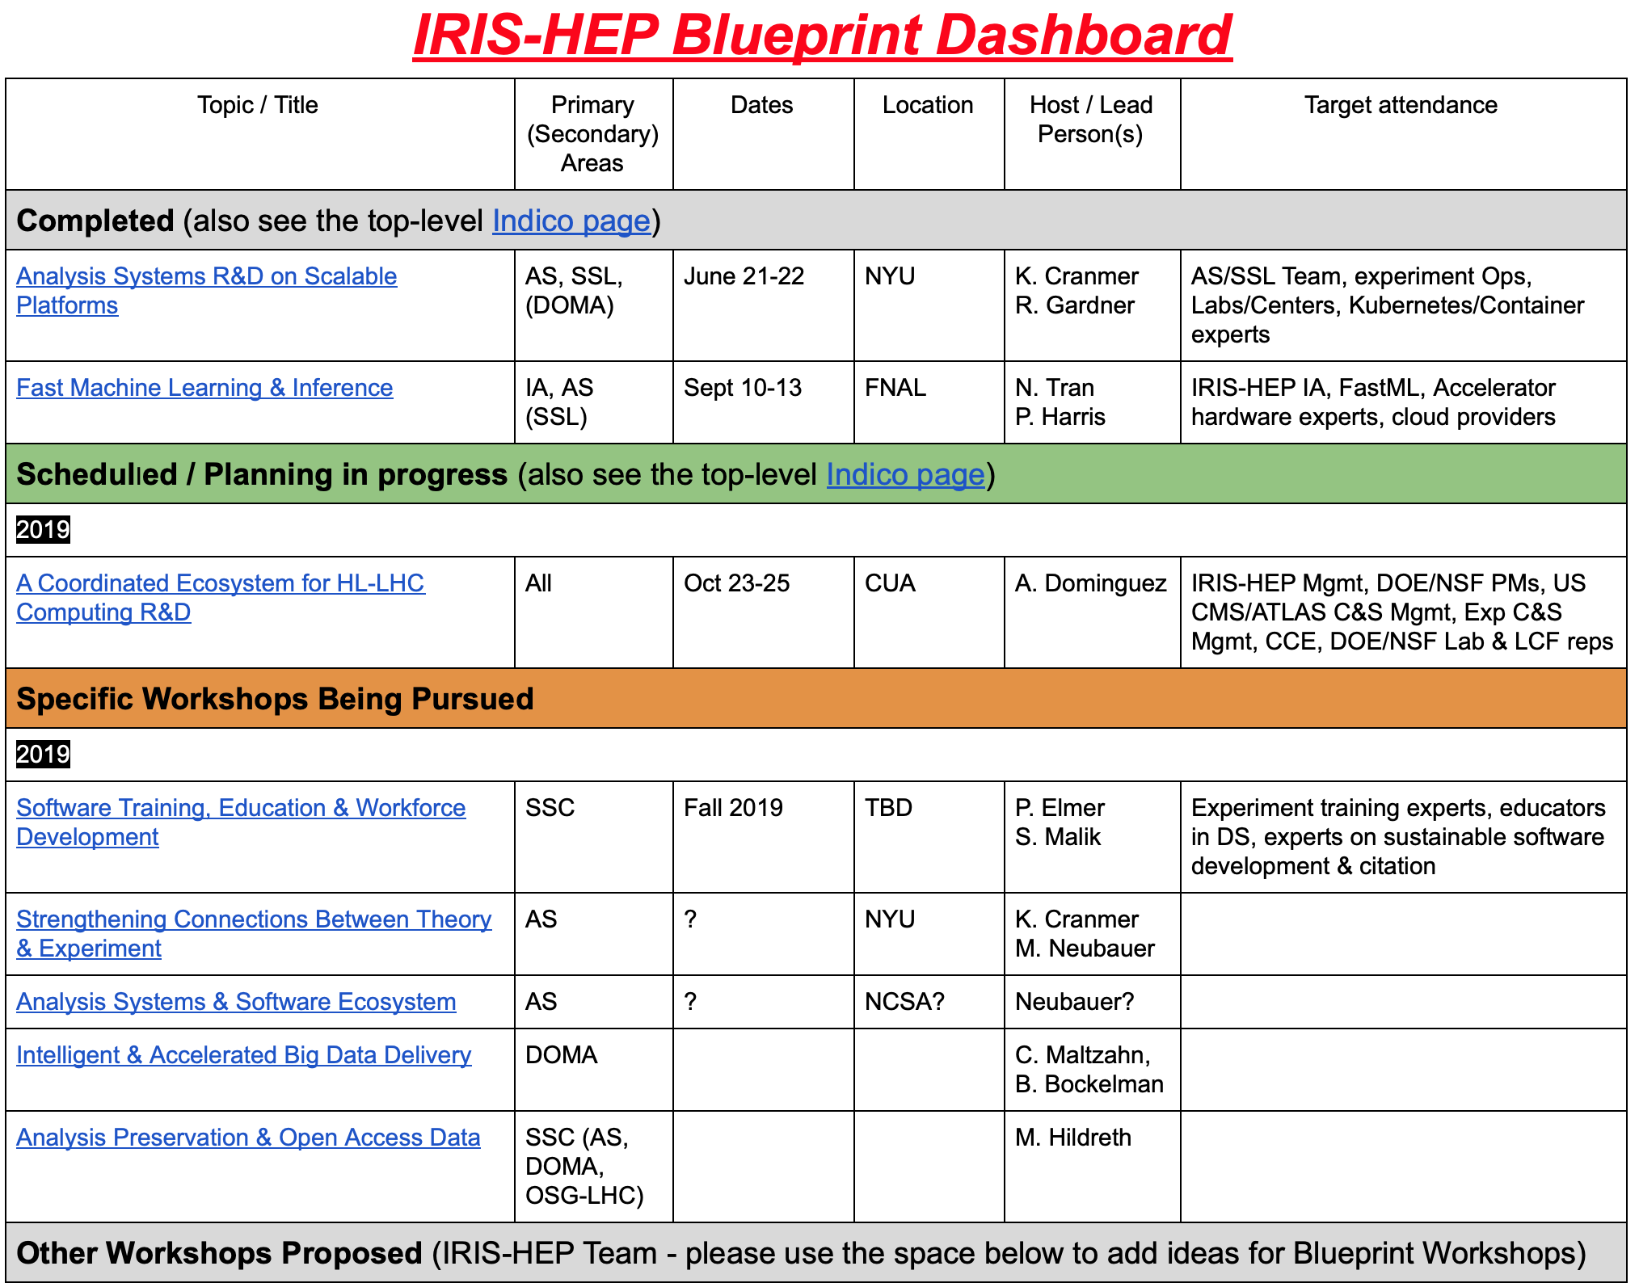
Blueprint Dashboard
We maintain a Blueprint Dashboard to aid in managing and planning around the activity
We regularly solicit ideas for Blueprint workshop topics from key stakeholders and others in the community

Slide 8
Blueprint Workshops
Completed
Analysis Systems R&D on Scalable Platforms (June 21-22 at NYU)
Accelerated Machine Learning and Inference (Sept 10-11 at Fermilab)
Scheduled
A Coordinated Ecosystem for HL-LHC Computing R&D (Oct 23-25 at CUA)
In the planning stage
Training, Education & Workforce Development
Efficient & Sustainable Software for Research
Strengthening Connections between Theory & Experiment
Analysis Systems & Software Ecosystem
Intelligent & Accelerated Big Data Delivery
Analysis Preservation & Open Access Data

Slide 9
AS/SSL Blueprint Workshop
Analysis Systems R&D on Scalable Platforms (June 21-22 @ NYU)
Benefited from proximity to the Analysis Systems Topical Workshop (immediately proceeding it) and the ATLAS Software & Computing Week which directly followed
Major Goals
Review the status of the Analysis Systems (AS) milestones and deliverables to inform that needs for a collaborative development and testing platform
Develop the Scalable Systems Laboratory (SSL) architecture and plans, using AS R&D activities as concrete examples
Develop requirements on SSL to support the AS area, particularly the prototyping, bench- marking and scaling of AS deliverables toward production deployment
Increase the visibility of SSL and AS beyond IRIS-HEP to facilitate partnerships with organizations that could potentially provide resources toward these objectives
Get informed on the latest developments in open source technologies and methods important for the success of the SSL and AS R&D (and IRIS-HEP, generally)

Slide 10
AS/SSL Blueprint Workshop
Analysis Systems R&D on Scalable Platforms (June 21-22 @ NYU)
Productive discussions among the AS & SSL teams and representatives from NCSA, SDSC, NYU Research Computing, Google and RedHat (26 registered participants)
Key Outcomes
Communication of the AS area plans leading to a set of requirements to the SSL team
Kubernetes identified as a planned common denominator technology for the SSL, increasing innovation capability through flexible infrastructure.
Plans for a multi-site SSL substrate project that will federate SSL contributions from multiple resource providers, offering the AS area a flexible platform for service deployment at scales needed to test the viability of system designs.
A concrete vision for an SSL that serves not only as an innovation space for AS developers, but as a testbed to prototype next generation infrastructure patterns for future HEP computing environments.

Slide 11
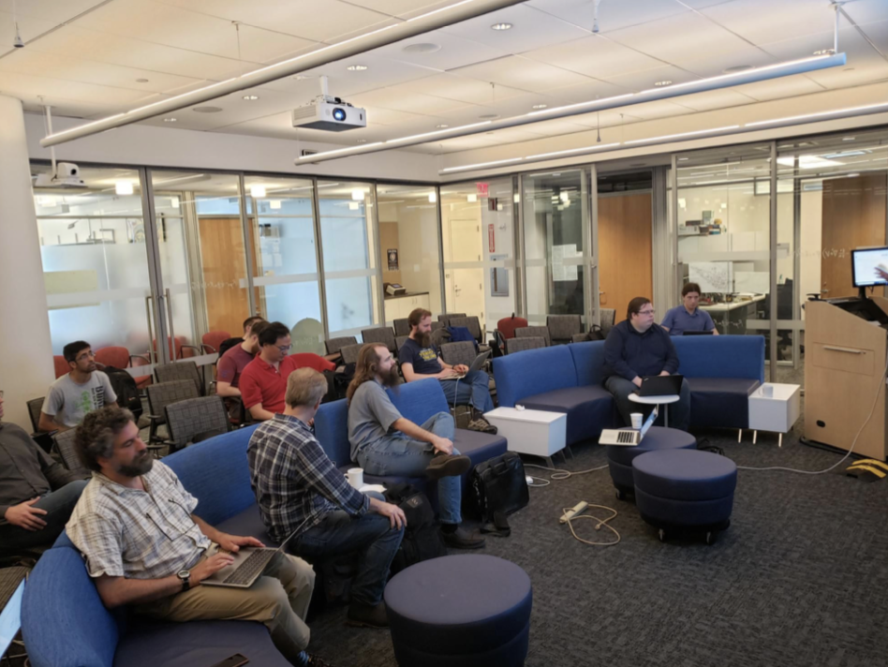
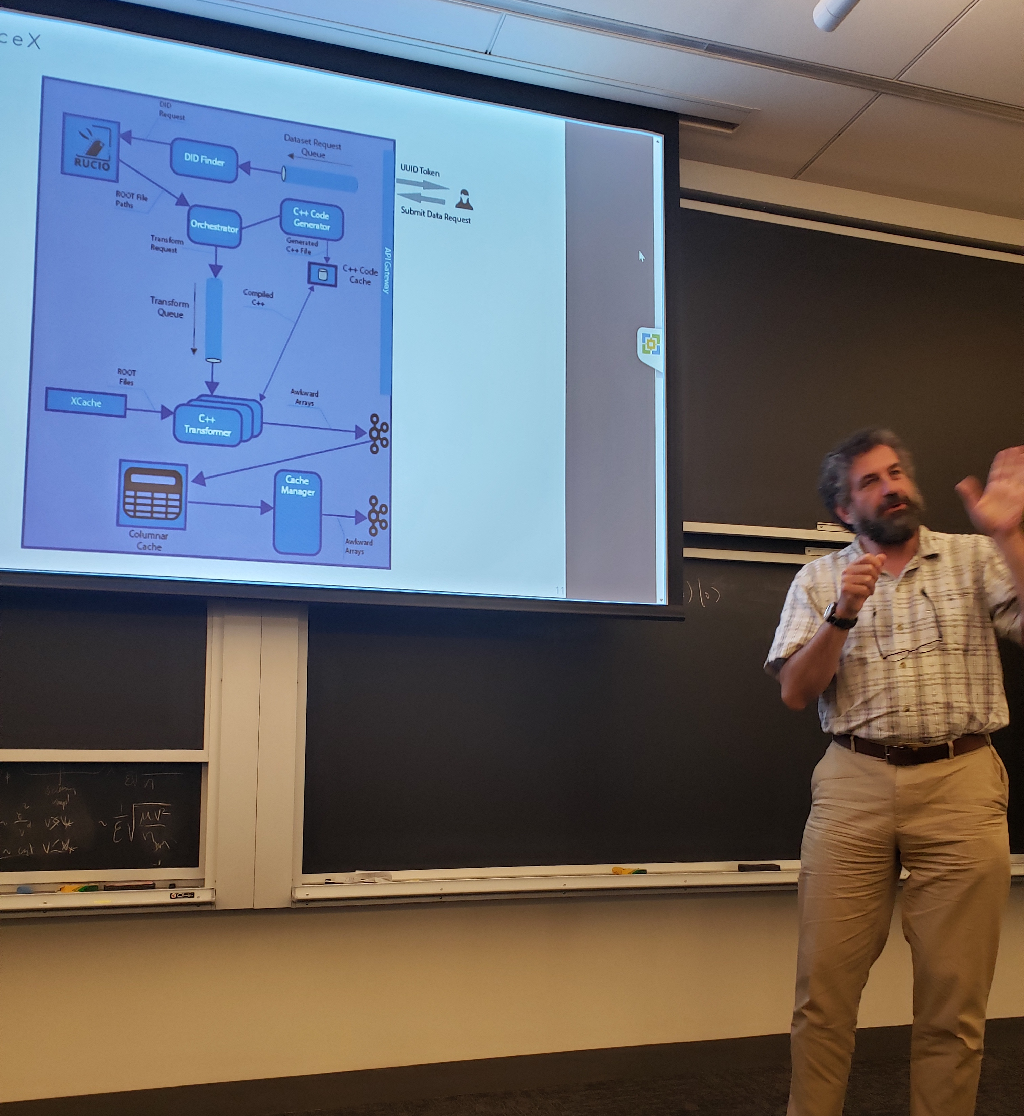
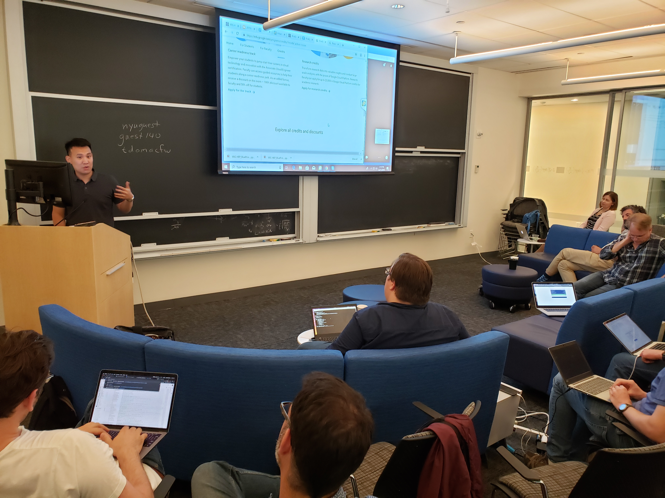
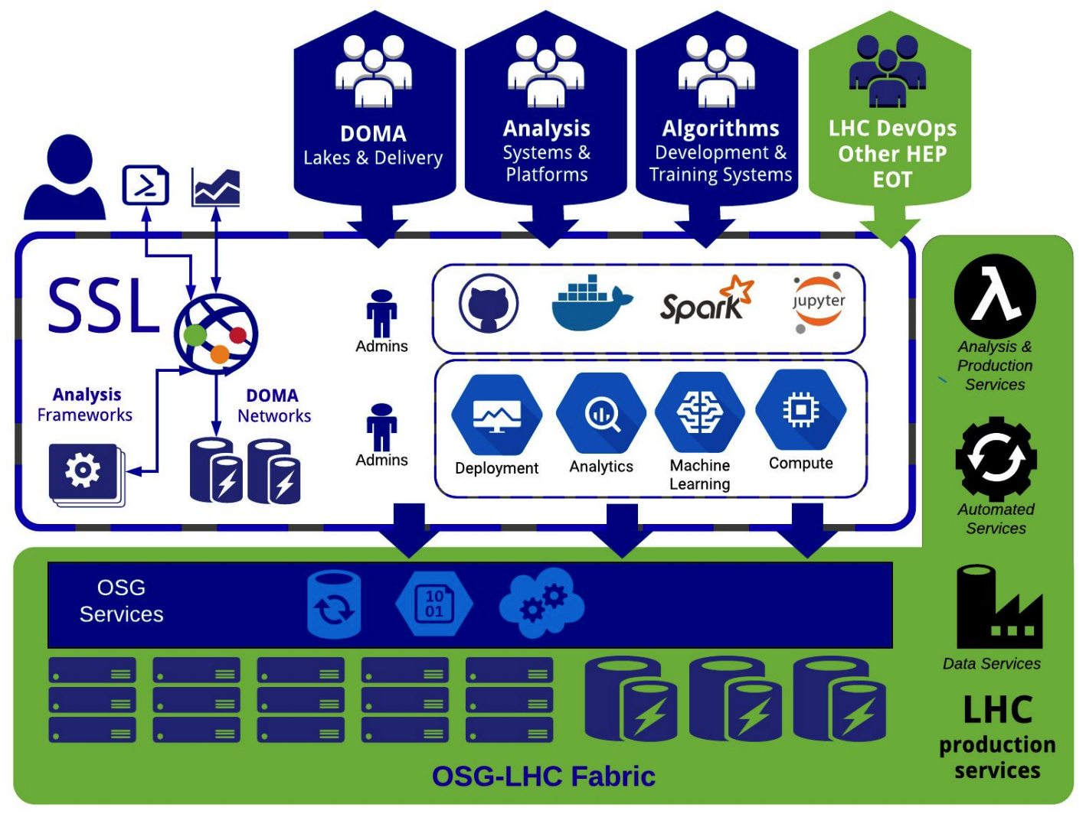
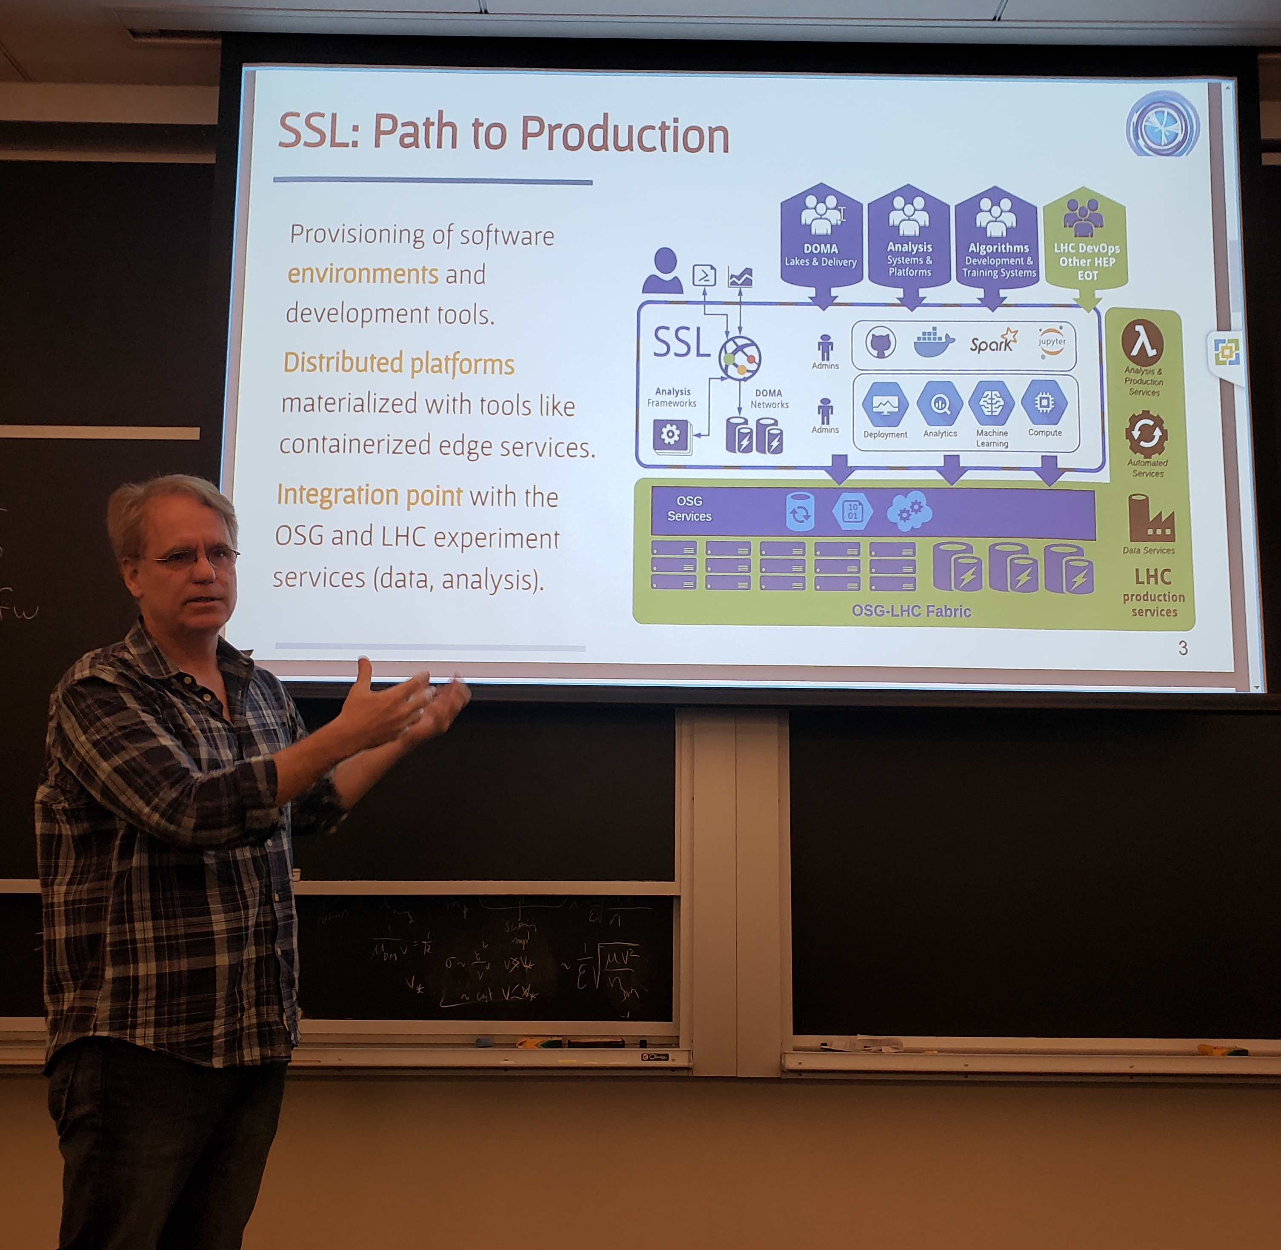
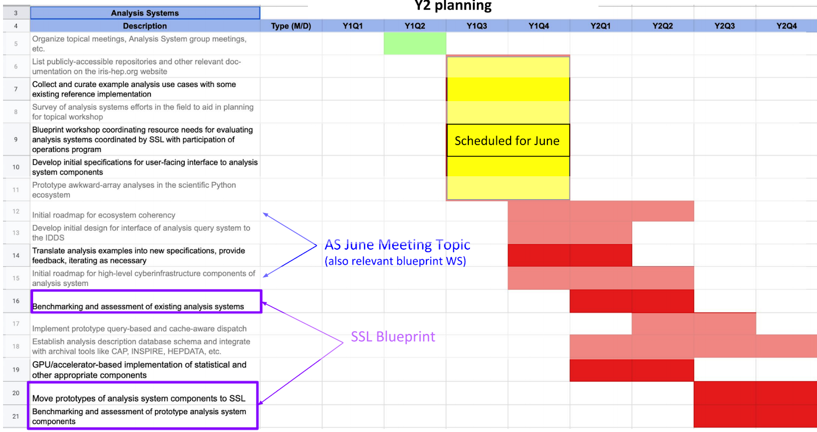
AS/SSL Blueprint Workshop

Slide 12
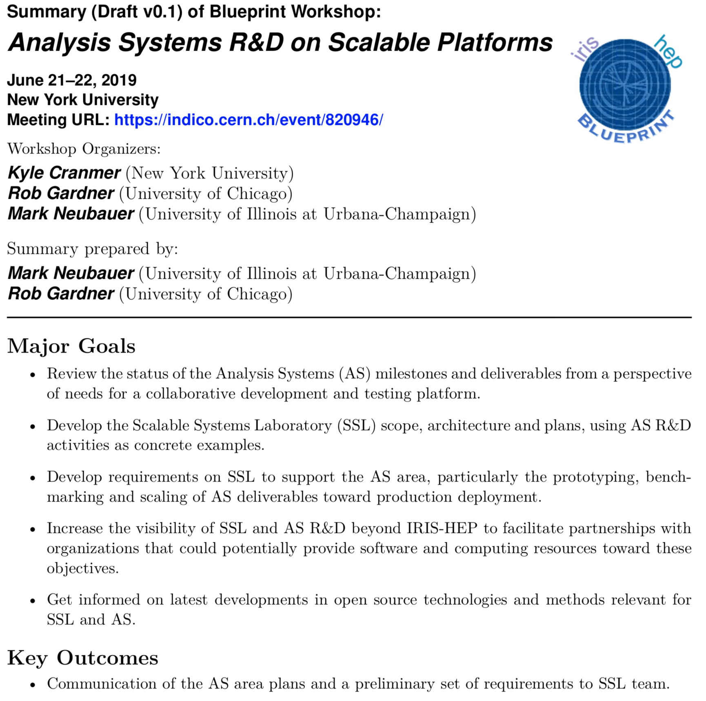
AS/SSL Blueprint Workshop Report
A (draft) report summarizing the workshop’s major goals, activities and key outcomes can be found here

Slide 13
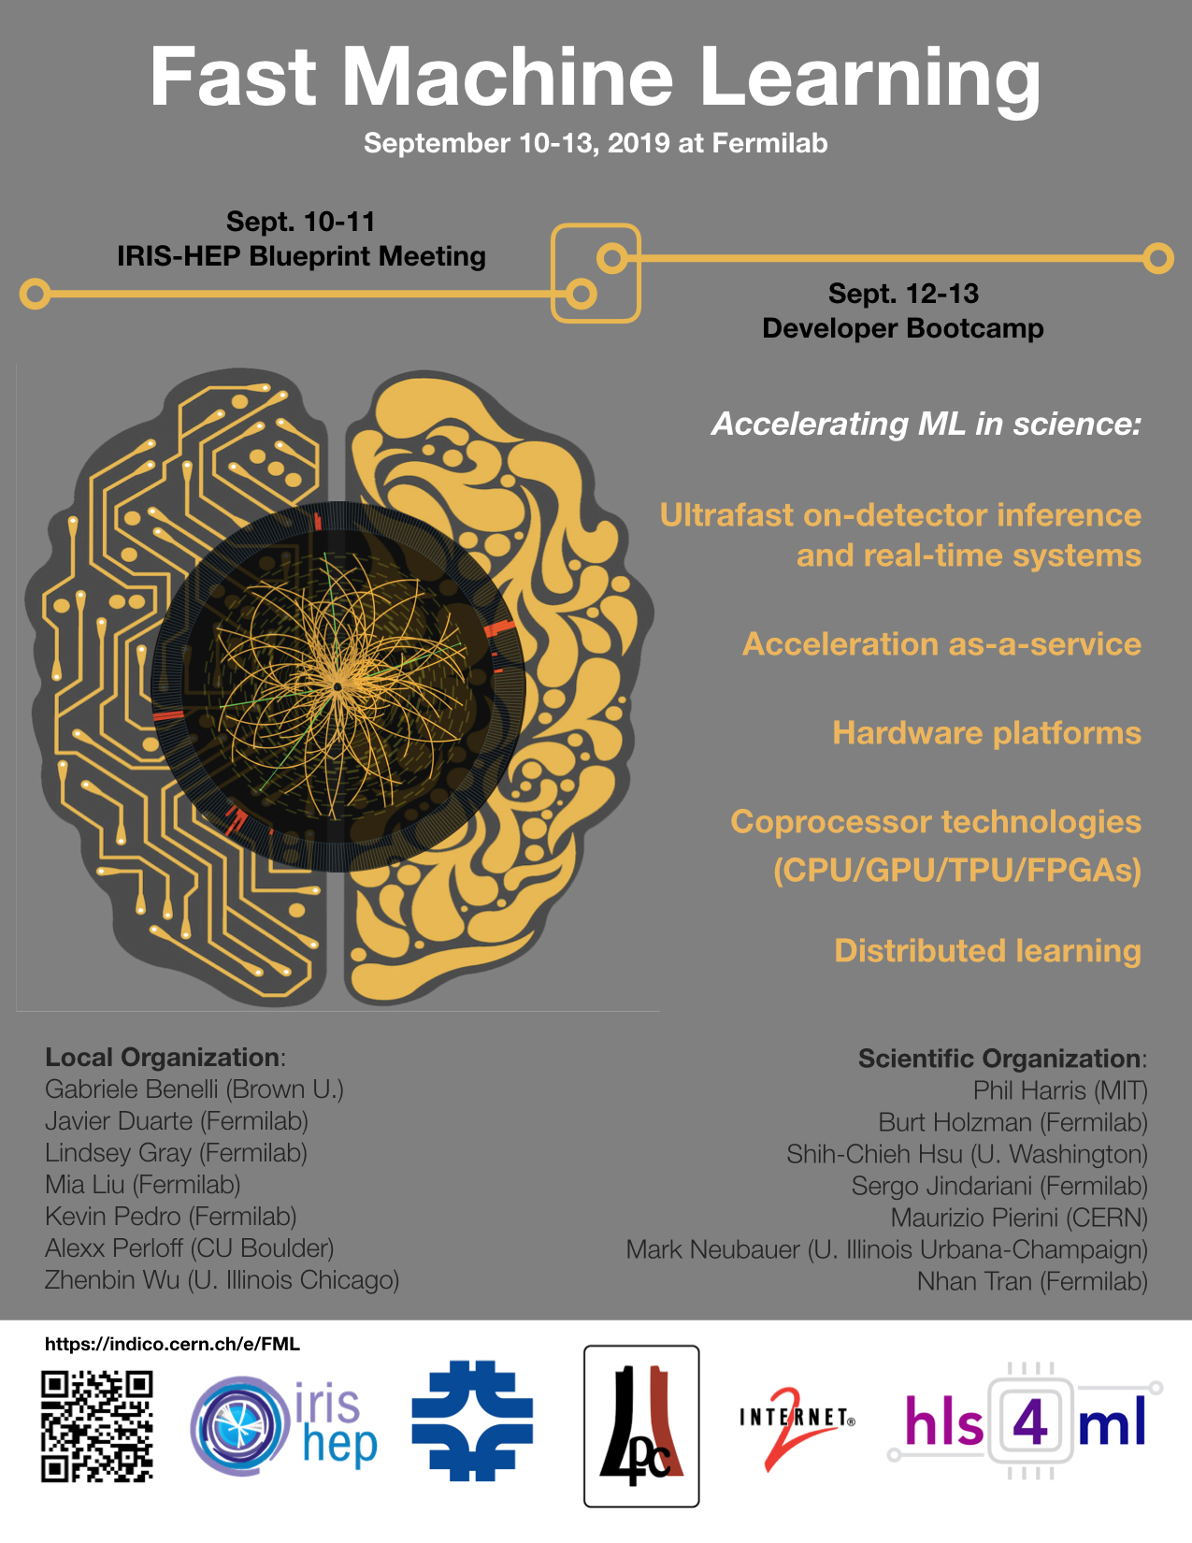
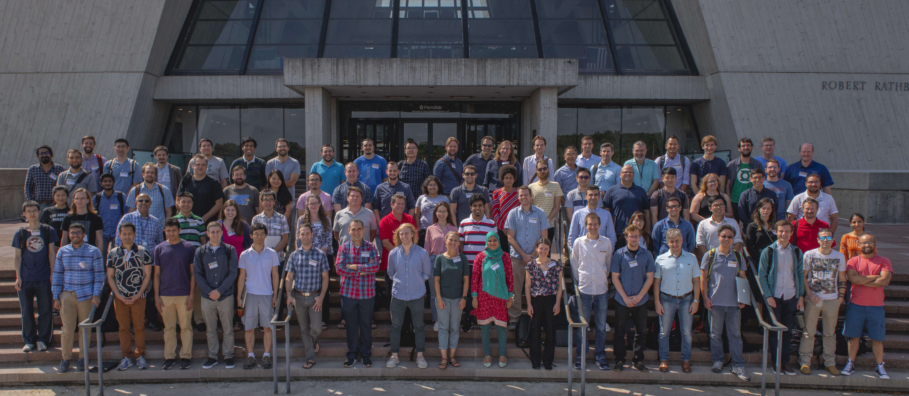
FastML Blueprint Workshop
Fast Machine Learning and Inference (September 10-11 @ FNAL)
Hosted at the Fermilab LPC and co-located with the FastML “developer bootcamp” which held tutorials and hackathon (195 registered participants!)

Slide 14
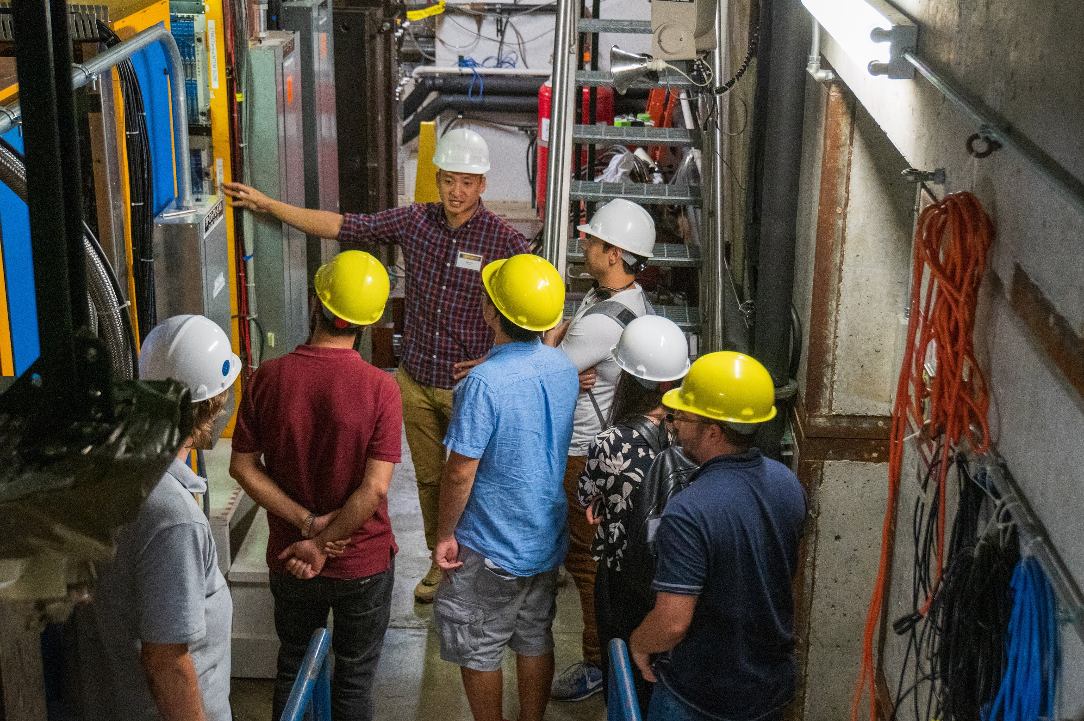
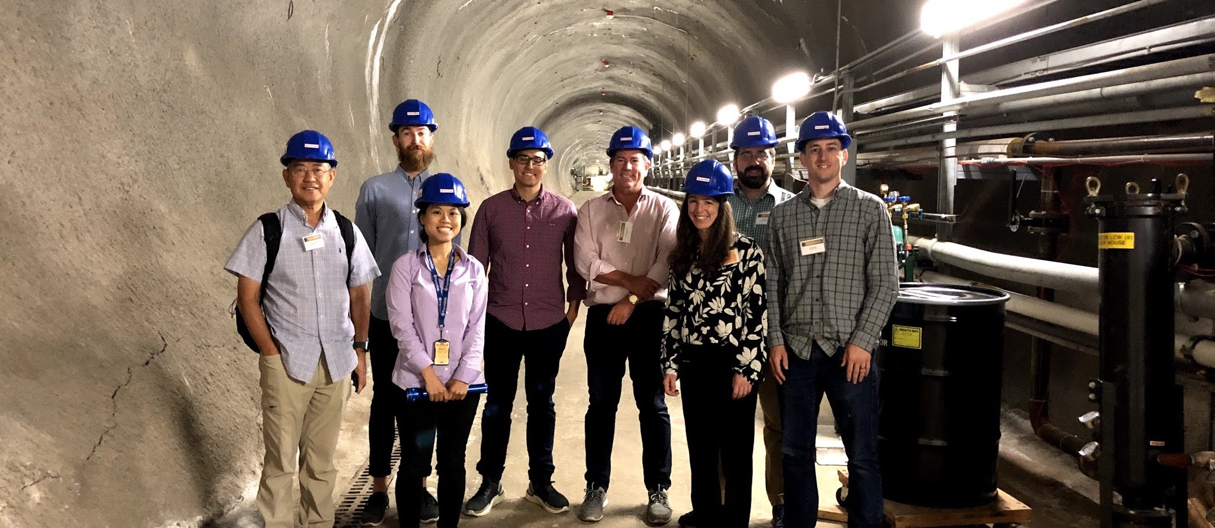
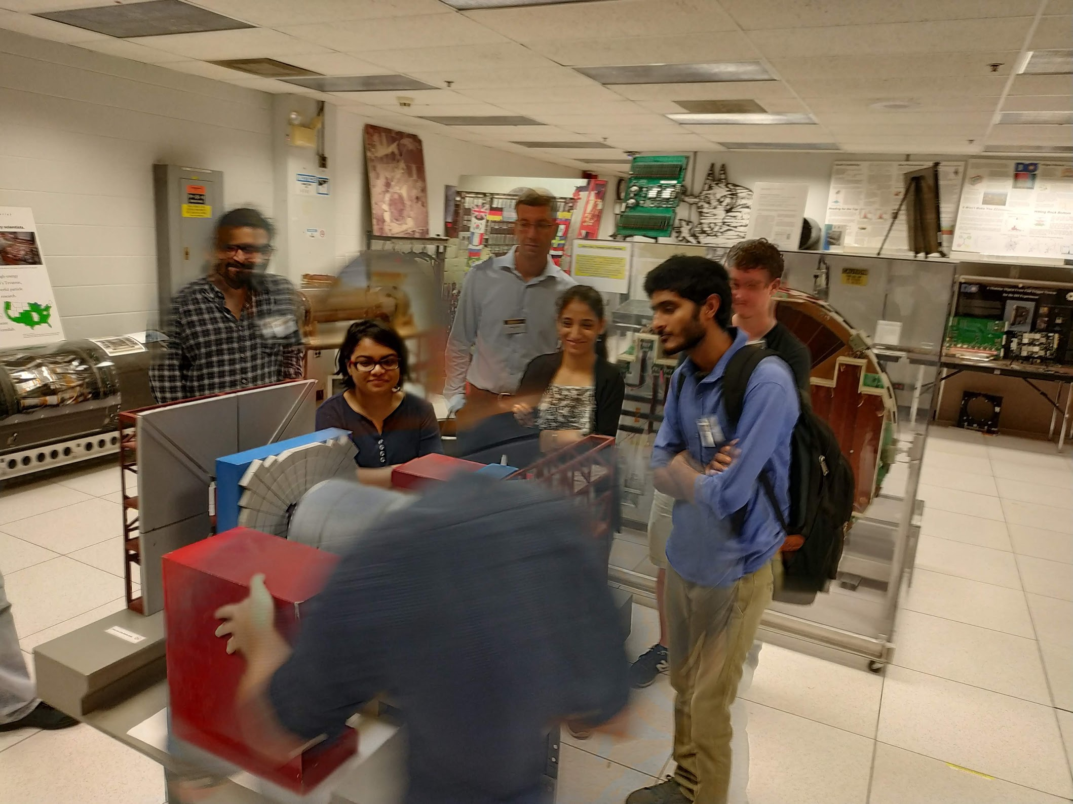
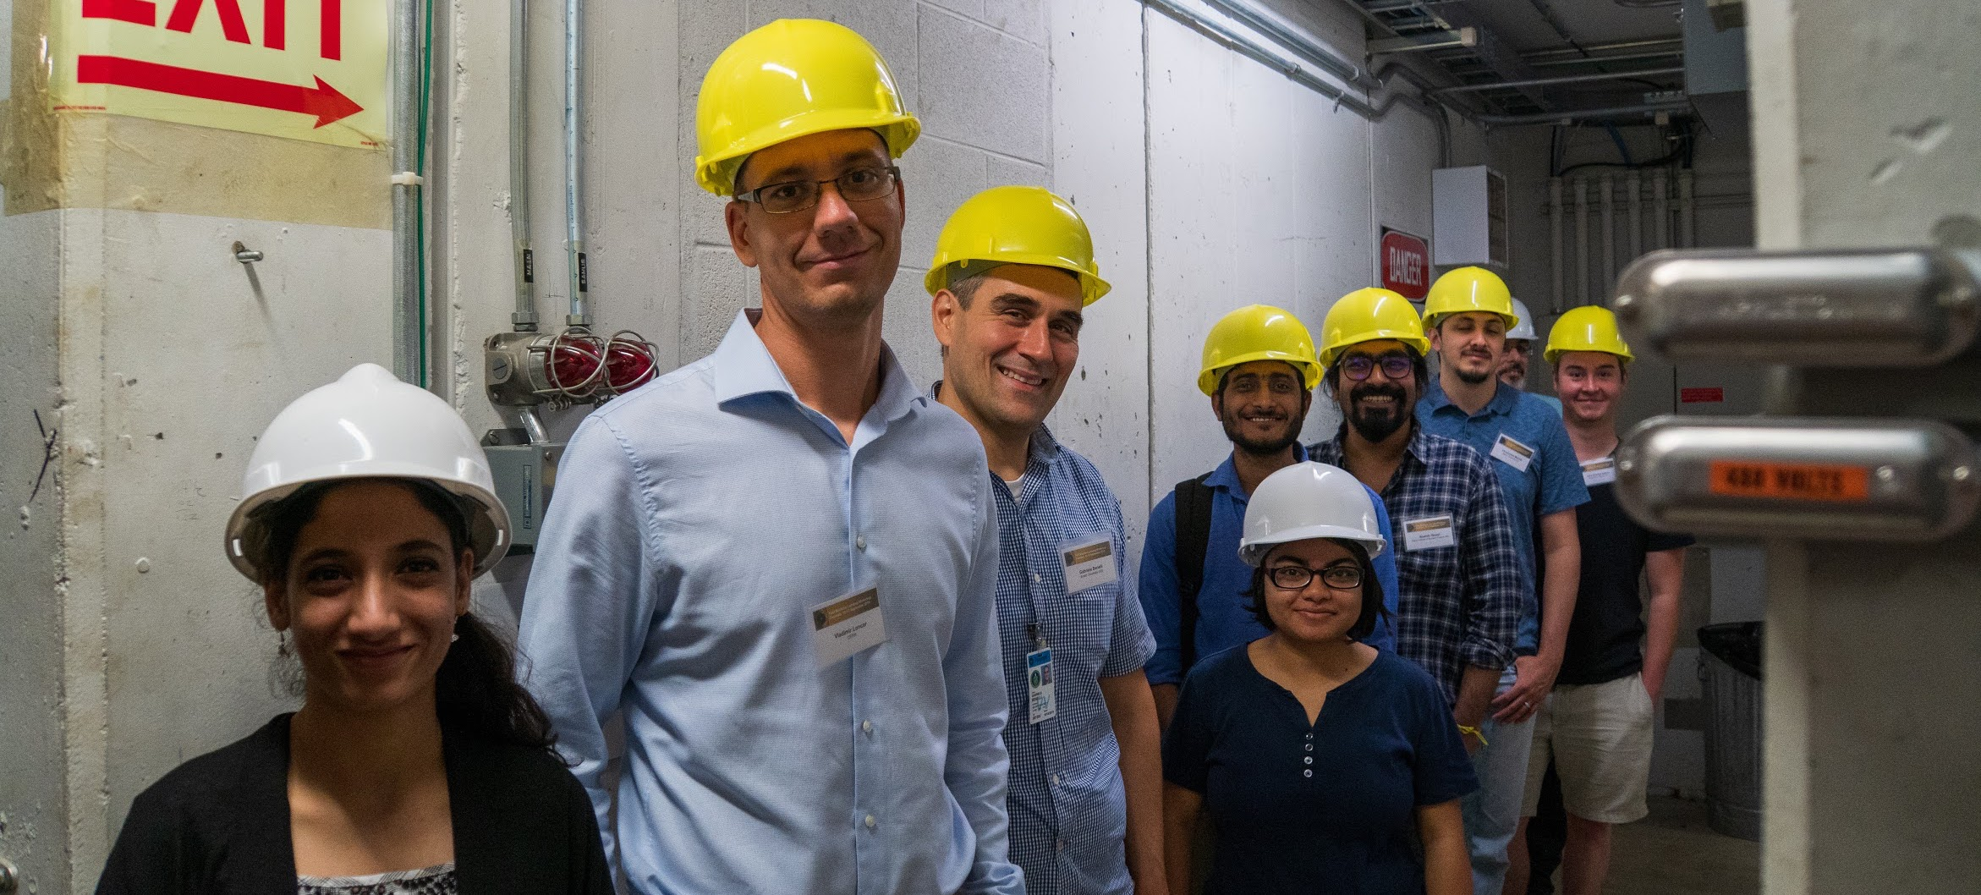
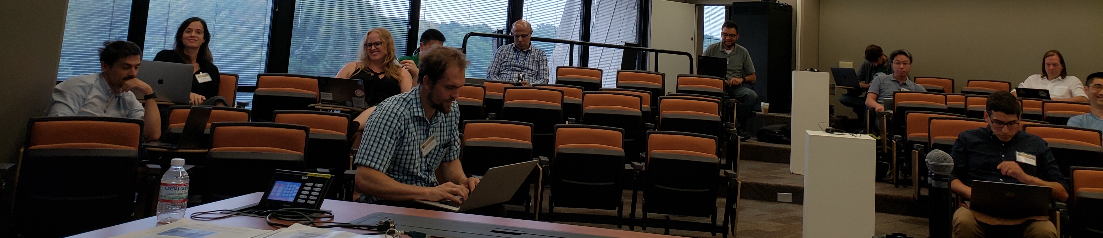
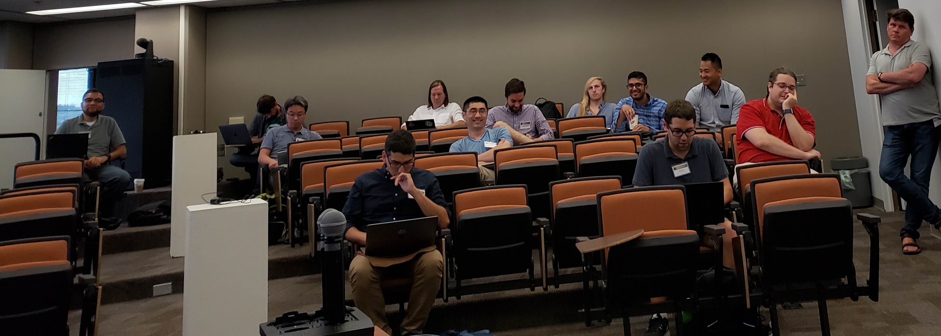
FastML Blueprint Workshop
Day 1
Tours (Dzero/Tevatron, Neutrino Campus, GCC)
Overview of triggering & real-time systems (Isobel Ojalvo)
Future computing architectures (Paolo Calafiura)
Energy-efficient Machine Learning (Andreas Moshovos)
(Fast) ML at the LHC (Jean-Roch Vlimant)
(Fast) ML in Cosmology (Brian Nord)
(Fast) ML for Accelerators (Auralee Edelen)
(Fast) ML for Neutrinos (Georgia Karagiorgi)
(Fast) ML for Gravitational Waves (Eliu Huerta Escudero)
Day 2
Real-time AI Systems (Academia) (Giuseppe Di Guglielmo)
Real-time AI Systems (Industry) (Jason Vidma)
Neuromorphic Photonics (Liane Bernstein)
Heterogeneous Computing as a Service (Academia) (Naif Tarafdar)
Heterogeneous Computing as a Service (Industry) (Andrew Putnam)
HLS4ML Status (Jennifer Ngadiuba)
SONIC Status (Miaoyuan Liu)
Training over Distributed Computing Systems (J.-R. Vlimant)
Distributed Training on HPC (Aaron Saxton)
Scalable Systems Laboratory (Rob Gardner)
Real-time RF Processing (EJ Kreinar)
Reconstruction at Nova (Thomas Warburton)
Deep Cleaning for Gravitational Wave Data (Tri Nguyen)
Graph NNs for LHC reconstruction (Lindsey Gray)
IRIS-HEP & Community planning breakout (2 hours)
University
Lab
Industry

Slide 15
FastML Blueprint Workshop
Fast Machine Learning and Inference (September 10-11 @ FNAL)
Major Goals
Summarize the current state of R&D in this area and get informed by experts on the latest technologies in fast machine learning and inference
Communicate and contrast the various technological choices available for both hardware trigger algorithms and heterogeneous computing with accelerated ML
Build & educate the community for developing a wide range of accelerated ML use-cases
Review the Milestones & Deliverables in Fast ML and plan for Y2 / 18-month review
Desired Outcomes & Deliverables
Develop a roadmap of trigger & computing applications from near term to blue sky
Establish a hardware demonstration platform work plan at multiple sites
Establish partners for possibilities for connecting with use-cases outside of LHC
Generate a Blueprint report summarizing the workshop goals, activities and key findings

Slide 16
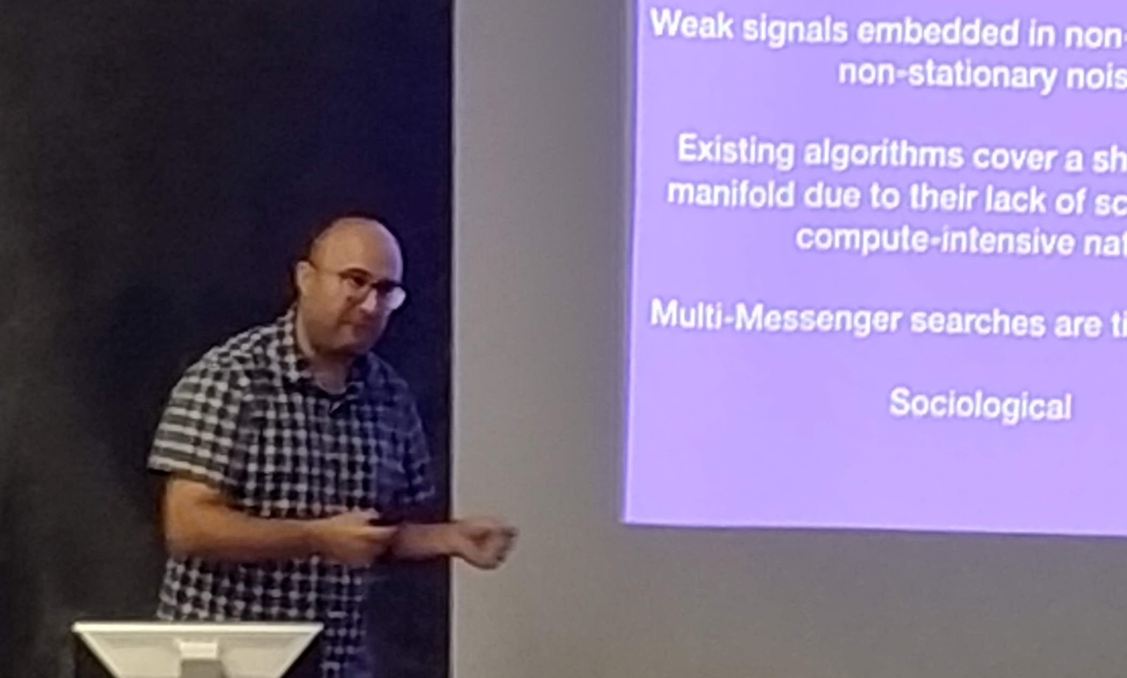
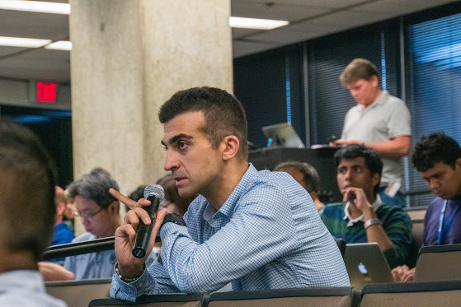
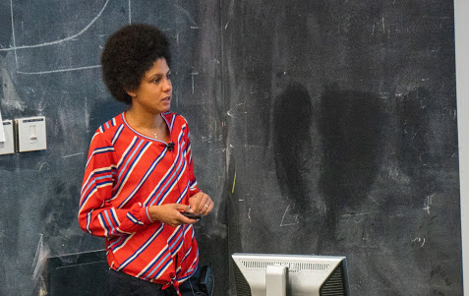
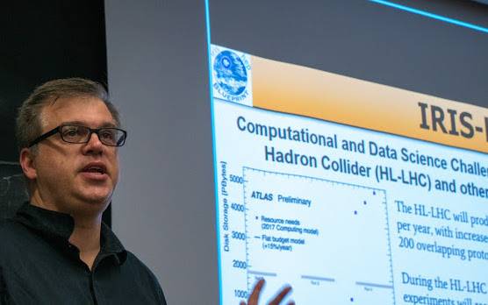
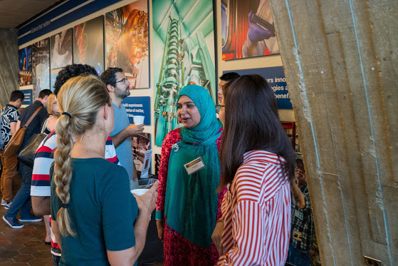
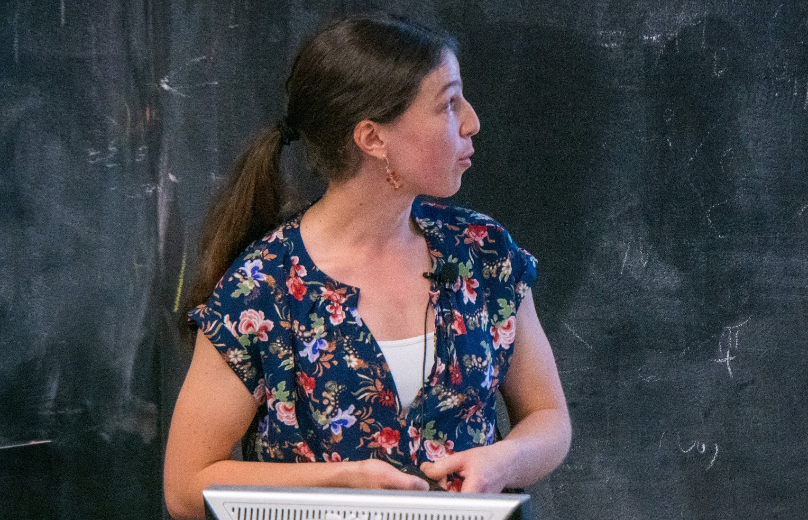
FastML Blueprint Workshop

Slide 17
Blueprint Workshops: Onward…
Completed
Analysis Systems R&D on Scalable Platforms (June 21-22 at NYU)
Accelerated Machine Learning and Inference (Sept 10-11 at Fermilab)
Scheduled
A Coordinated Ecosystem for HL-LHC Computing R&D (Oct 23-25 at CUA)
In the planning stage
Training, Education & Workforce Development
Efficient & Sustainable Software for Research
Strengthening Connections between Theory & Experiment
Analysis Systems & Software Ecosystem
Intelligent & Accelerated Big Data Delivery
Analysis Preservation & Open Access Data

Slide 18
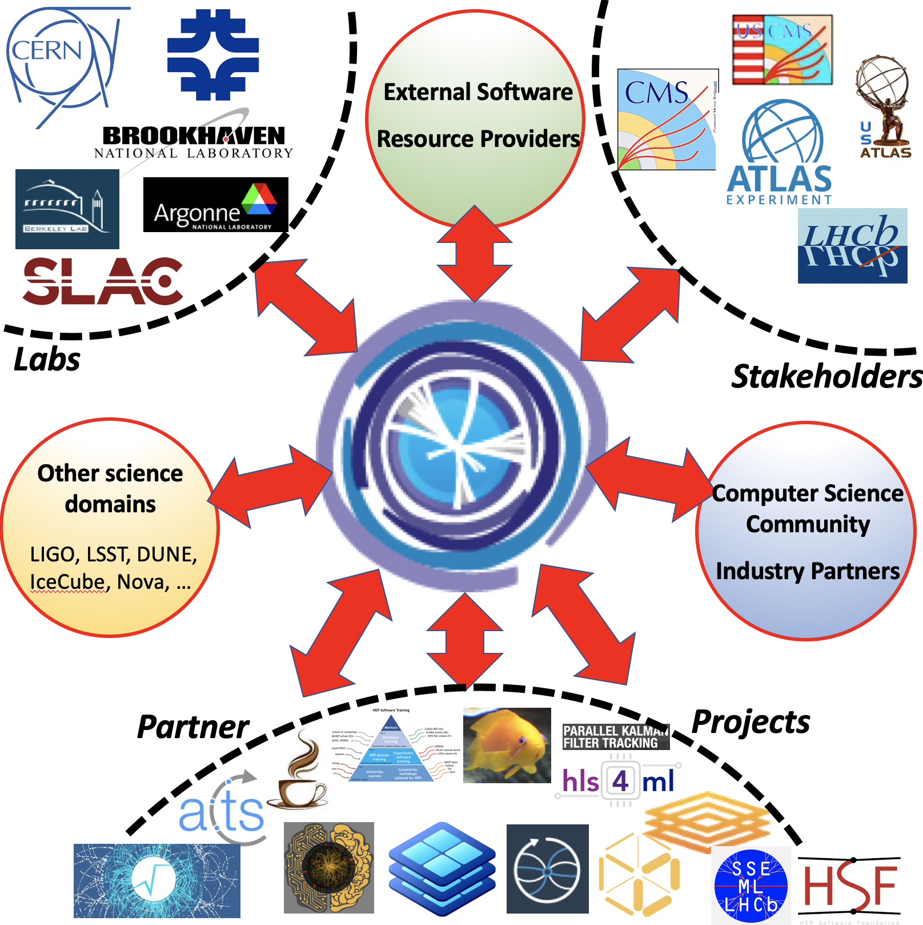
Intellectual Hub
IRIS-HEP is establishing itself as an intellectual hub for HEP software & computing
The Blueprint Activity plays an important role in this process
THANKS!

